Slide 1
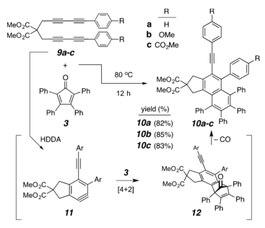
Nap - Naphthalene
My understanding is that all of the molecular families we looked at capitalize on a HDDA cycloisomerization reaction. Is that true?
Yes
The paper describes these molecules as alkynyl substituted naphthalenes. How/ do I need to refer to the parts outlined in orange and green? Because they do not contribute directly to the chromophore of the molecule it is not essential to comment on them, but if you like, then something like "both the quasiorthogonal phenyl substituent (orange) and the geminal carbomethoxy groups on the fused cyclopentano ring (green) serve to add steric bulk in the thrid dimension, namely above and below the plane of tht naphthalane ring, which will affect the way the molecules associate with one another in both amorphous films and crystalline arrays."
Proposed Reaction Description:
HDDA cascade reaction between 9 and 3 proceeds via benzynes 11 and their Diels−Alder adducts 12, ejecting a carbon monoxide to produce 10. Perfect.
COOMe - Methoxycarbonyl group
OH - hydroxyl group
Alkynyl group
Naphthalene

Slide 2
Triben – tribenzene?
Based on my understanding, I would refer to these molecules as doubly alkynylly substituted benzene. Is that correct to say? Close. Better as something like 1,4-bis(arylethynyl) benzene derivatives.
I would like to produce a reaction description and graphic, similar to the previous molecule. I would guess that I just need to know the equivalent of 3 in the previous diagram. Did Feng make something like this diagram for his thesis that I could refer to? It would look something like that shown in the slide I pasted in (#4). I suggest to meet with Xiao Xiao and have him help you with the scheme you would like.
For this and the next slide, this is unpublished work by us (I don’t know if you have published the chemistry separately). Is it ok for me to show the molecules and describe the reaction? If not, I can just refer to them by representative names. Please advise. Thanks for asking. I have no problem with your showing this. We have not yet published these results, but Xiao is working on a manuscript.

Slide 3
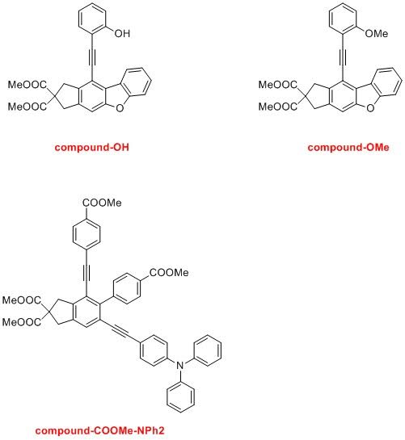
I don’t know how to describe these or the reaction pathway
The first is an arylethynyldibenzofuran and the second, a 1,3-bis(arylethynyl)naphthalene derivative. Again, Xiao can advise you on the reaction scheme.
The thermal HDDA reaction of tetrayne 1 afforded the arylethynyldibenzofuran 5. The reaction proceeds through three reactive intermediates: benzyne 2, zwitterion 3, and oxonium ion 4.

Slide 4
Under a Copper catalyzed condition, the arylalkyne (blue color) can produce catalytic amount of copper acetylide (in box), which would rapidly trap the benzyne generated by the HDDA reaction. The resulting aryl copper species (bottom right) can be protonated to afford the two final products and regenerate the copper catalyst.

Slide 5
Copper-promoted (HDDA? and) benzyne alkynylation

